Slide 1


Magic bag of
30 transcription tricks
When Just EARS Aren’t Enough!
Karen Steffen Chung 史嘉琳
台大外文系 副教授
https://www.allegistranscription.com/wp-content/uploads/2016/03/lady-headset.jpg
http://www.plaqueoff.com/animal/img/_SDC/plaqueoff-page-DOG-LISTENING.jpeg

Slide 2
index
1. Ears/brain
2. Vowels
3. Phonics
4. Final C
5. Nasals
6. Slow audio
7. Reductions
8. Word stress
9. Compounds
10. Intonation
11. Markers
12. Grammar
13. Checklist
14. Linggle
15. Images
16. Self-correct
17. Story tense
18. Linking
19. Syllables
20. Chinese
21. Right-click
22. OneLook
23. Capitals
24. Names
25. Repetition
26. Rhyme
27. h-dropping
28. Dialect
29. Logic
30. Guess!!

Slide 3

1. Your Ears and brain
Your trick of first resort:
Listen CAREFULLY, listen CLOSELY,
listen AS MANY TIMES AS NECESSARY.
http://www.chiropracticanchorage.com/wp-content/uploads/2013/09/Child_holding_ears.jpg

Slide 4

Does what you wrote MAKE SENSE?
In Michigan, the medal winner there is a good chance to wider touch freeze.
http://matthewlpowers.com/wp-content/uploads/2013/08/puzzled.jpg

Slide 5
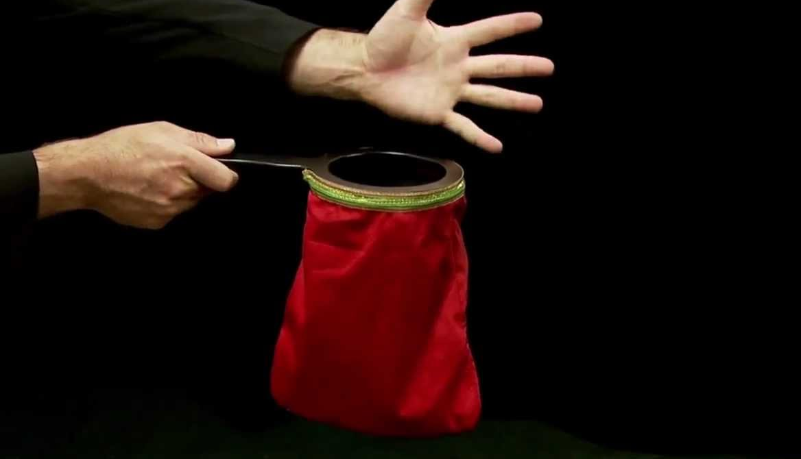
If not, you may need to pull some other tricks out of your bag!
https://i.ytimg.com/vi/yLOUgA7RE1Y/maxresdefault.jpg

Slide 6

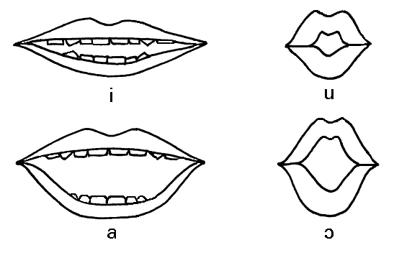
2. Vowels matter!
Your vowels must be CORRECT and PRECISE.
No sloppiness allowed –
train yourself every day!
http://clas.mq.edu.au/speech/phonetics/phonetics/vowelartic/lip_posture.gif
http://www.rlacortongillingham.com/wp-content/uploads/2015/03/vowels.png

Slide 7
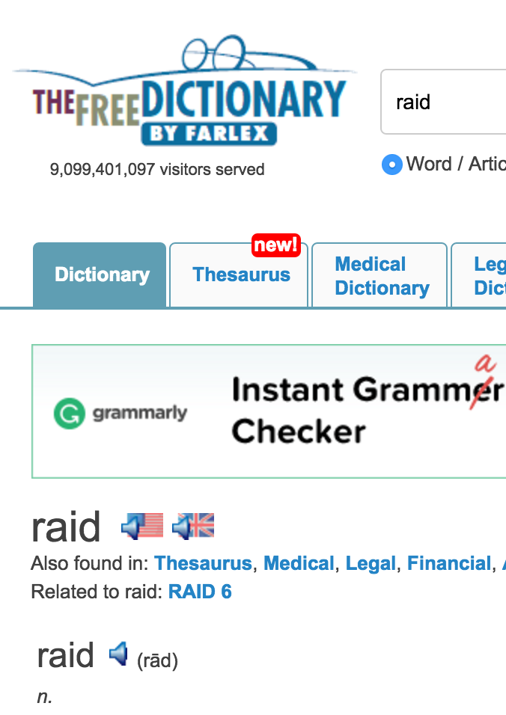
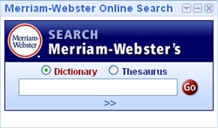
Use Merriam-webster and the free dictionary!
Listen – Echo – Repeat till it’s PERFECT!
If you can SAY it correctly, you’ll HEAR it correctly!
http://www.merriam-webster.com/images/downloadables/search_homepage_google1.jpg
http://www.thefreedictionary.com/raid

Slide 8
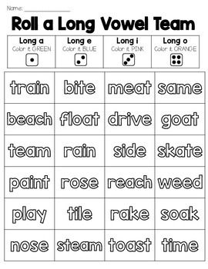
3. Learn basic phonics rules for vowels
Silent “e”
and double
vowel letters:
diphthongs and
“long” vowels
Single/double final
or double medial
consonant letters:
“short” vowels
https://s-media-cache-ak0.pinimg.com/564x/de/68/67/de6867208da64c74b1f8ad087dceccb4.jpg

Slide 9
4. Is the final consonant
Voiced or voiceless?
To distinguish voiced vs. voiceless
final consonants:
1. Vowel length 母音長度
2. Final voicing (not always clear)
詞尾子音有聲或無聲
3. Listen for the final creak
吱嘎音 as in「我」
4. Lower pitch 音高較低

Slide 10
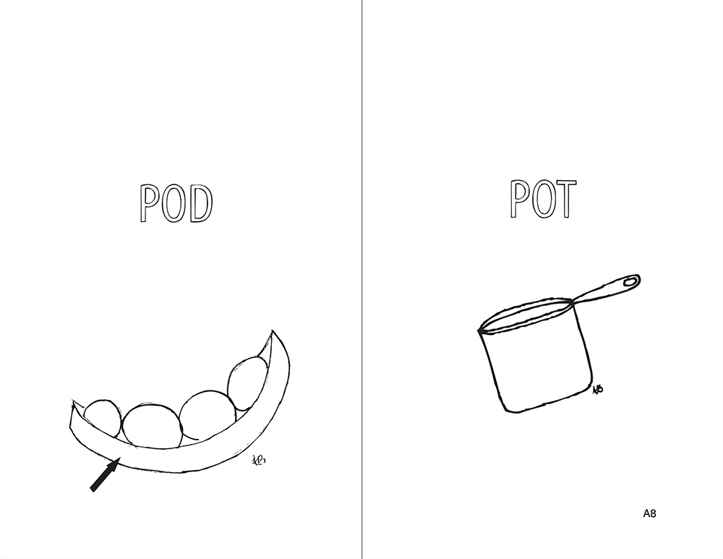
Examples of voiced vs. voiceless final stops
cop vs. cob
lit vs. lid
duck vs. dug
http://sunnyspeech.com/wp-content/uploads/2015/01/59.jpg

Slide 11
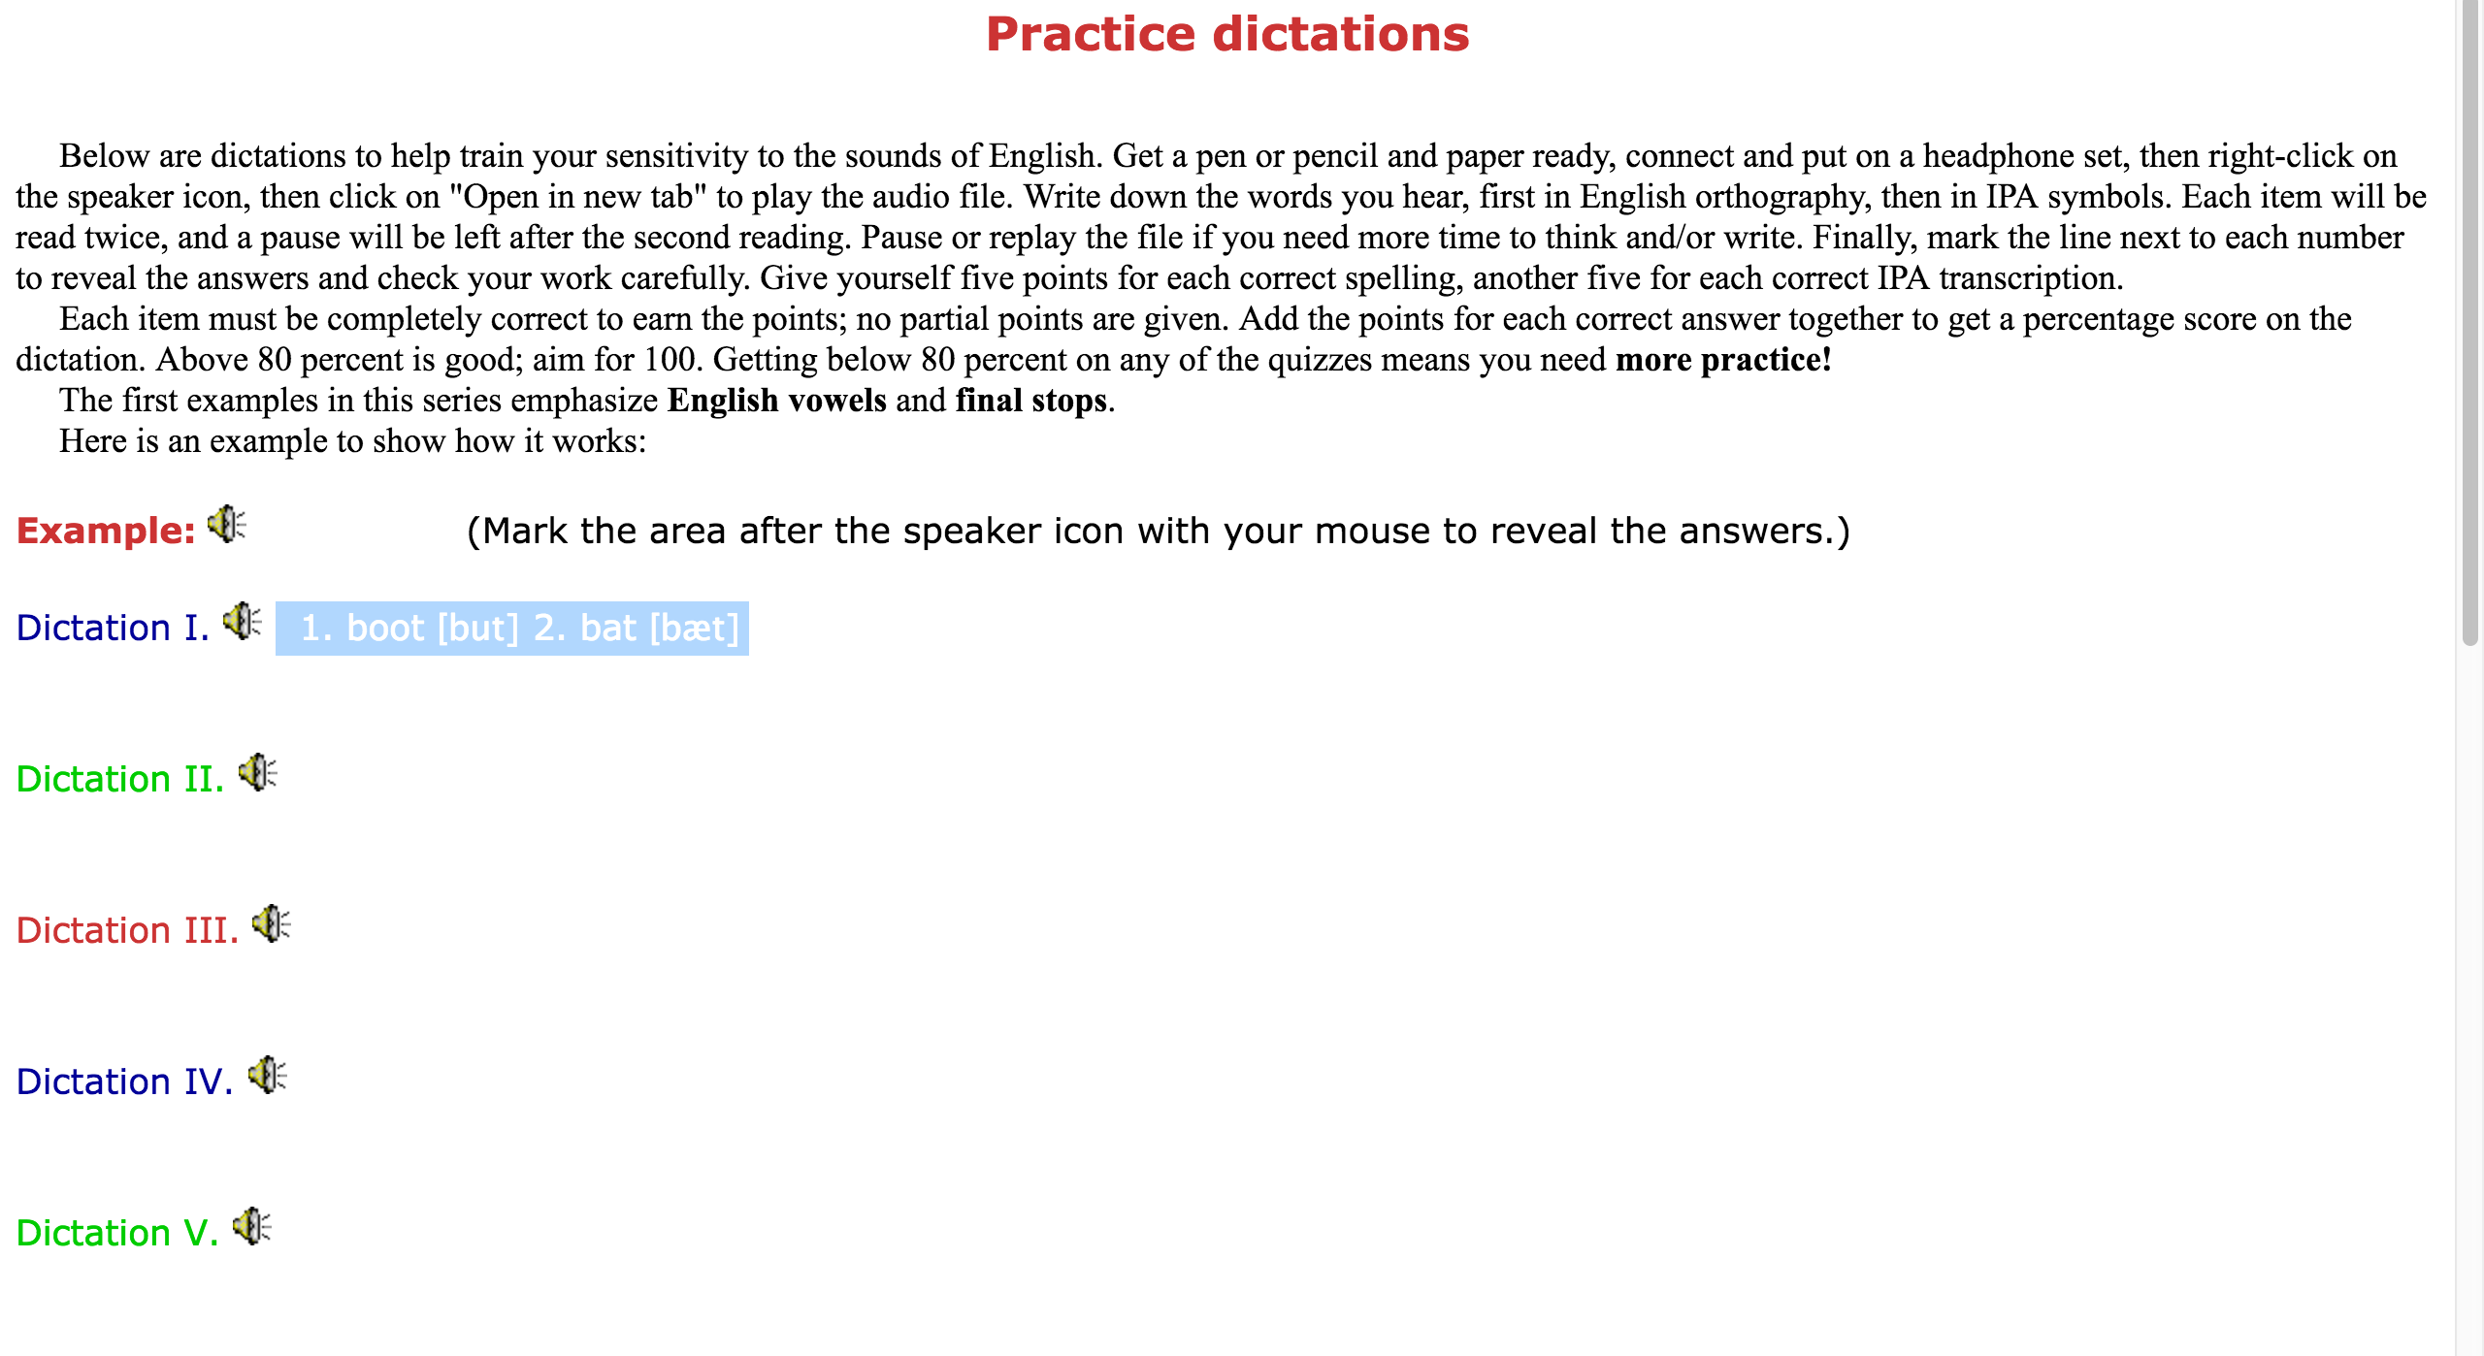
Do Practice dictations
They’re challenging! But stick with it and
eventually you’ll get better at it!
http://homepage.ntu.edu.tw/~karchung/phonetics/dictations.htm

Slide 12
Recognition can be asymmetrical 不對稱
One of a pair may be easy to recognize, while with the other you’re not sure.
This is also a way to distinguish the two sounds.
When you’re sure, it’s “kits”, when not, it’s “kids”!

Slide 13
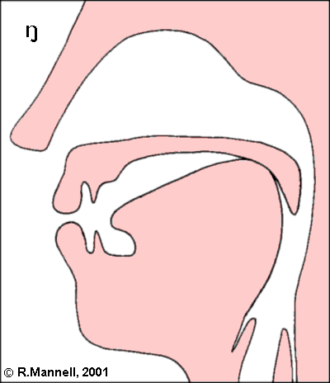
5. Work on nasal finals
/-m, -n, -ŋ/
Practice with minimal pairs
if you have trouble
distinguishing the
following endings:
ram ran rang
Tim tin ting
rum run rung
Remember than final /-n/
sounds like the ending of ㄢ;
/-ŋ/ sounds like the ending of ㄤ
http://clas.mq.edu.au/speech/phonetics/phonetics/consonants/images/velar_nasal.gif

Slide 14

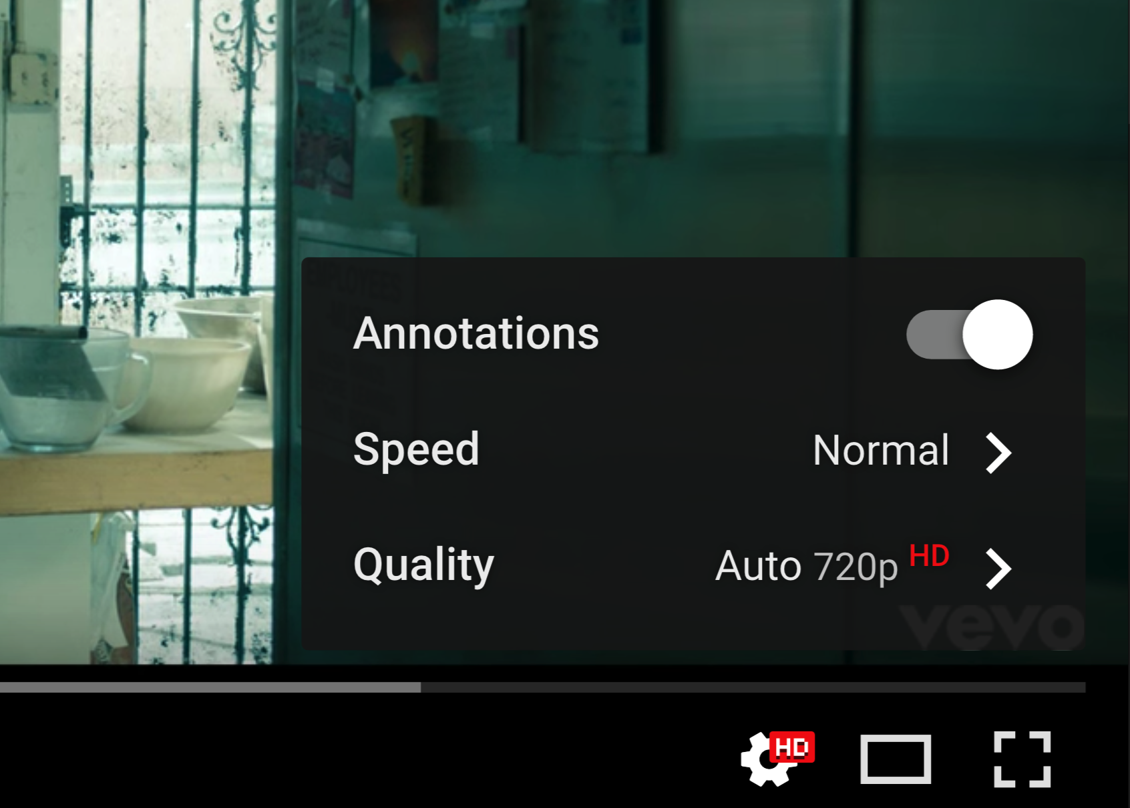
6. Slow down the audio
Slowing down the audio can help you hear unclear portions more clearly.
YouTube: Click on the gear icon , choose Speed, then Rate.
VLC: Click Playback, then Speed, then move the slider.
The same function should be available in other playback software.
https://www.youtube.com/watch?v=cmSbXsFE3l8

Slide 15
7. Learn reduced forms of function words: I
Content words:
nouns, verbs, adjectives, some adverbs
Usually STRESSED and CLEAR, unless repeated
Usually the easiest to understand
http://wwp.greenwichmeantime.com/time-zone/usa/michigan/

Slide 16
Learn reduced forms of function words: II
Function words:
Articles (the, a, an)
Conjunctions (and, but, or, if, though)
Prepositions (to, at, on, under, about)
Pronouns (I, me, you, he, him, she, her, it, we)
Helping verbs (am, is, were, have, has, had, will, can, could)
Some adverbs (today, yesterday, now, here, there)

Slide 17
Learn reduced forms of function words: III
Usually:
Unstressed
Fast
Reduced
Unclear
Harder to understand

Slide 18
Learn reduced forms of function words: Iv
Learn to recognize common reductions of function words:
And
In
On
Of
To

Slide 19
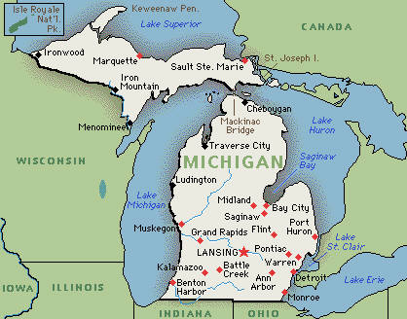
8. Pay attention to word stress!
If the word you wrote has a different STRESS pattern (with the same number of syllables) than what you heard, it’s probably not the right word,
e.g. MIchigan couldn’t be maCHINE,
saLIva couldn’t be SLIver.
However, many words also have one or more syllables with SECONDARY STRESS; sometimes the main stress will move to one of these, e.g.
GOOD AFter*NOON but AFternoon *TEA
http://wwp.greenwichmeantime.com/time-zone/usa/michigan/

Slide 20


9. Watch for compound noun stress
If the second of two nouns is not stressed, it may be a COMPOUND NOUN. Knowing this can help you decipher the word, e.g. *BACKpack, *SCHOOLbus.
http://images.sportsdirect.com/images/imgzoom/71/71302703_xxl.jpg
http://moparent.com/Websites/moparent/images/School_Bus_Hot_Wheels.jpg

Slide 21

10. Learn basic intonation rules:
Rule 1
The three rules of sentence intonation:
Rule 1: Stress the stressed syllables of all the content words in a sentence (like taxi, run, red;
do not stress function words, like in, the, my);
and the stressed syllable of the last content word in the sentence, the tonic stress, is pronounced with a high, falling intonation.
1. Who’s that *girl?
2. This is a *park.
3. A man is sitting on a *bench.
http://il8.picdn.net/shutterstock/videos/1583701/thumb/5.jpg

Slide 22
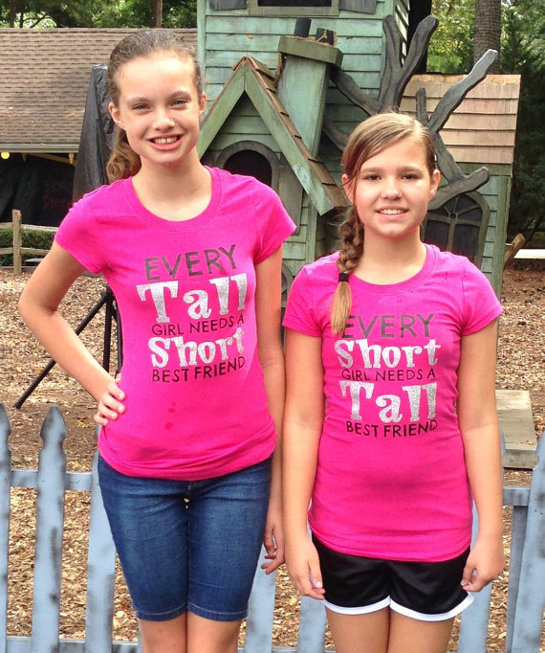
intonation rules:
Rule 2
Rule 2: After a subject has been introduced,
any new information is stressed;
old information is not stressed.
1. Who’s that *girl?
The *tall girl?
No, the *short girl.
Oh, that’s *Jane.
2. This is a *park.
There are trees, flowers, and *birds in the park.
https://img0.etsystatic.com/051/1/7848968/il_570xN.660898972_fd5o.jpg

Slide 23
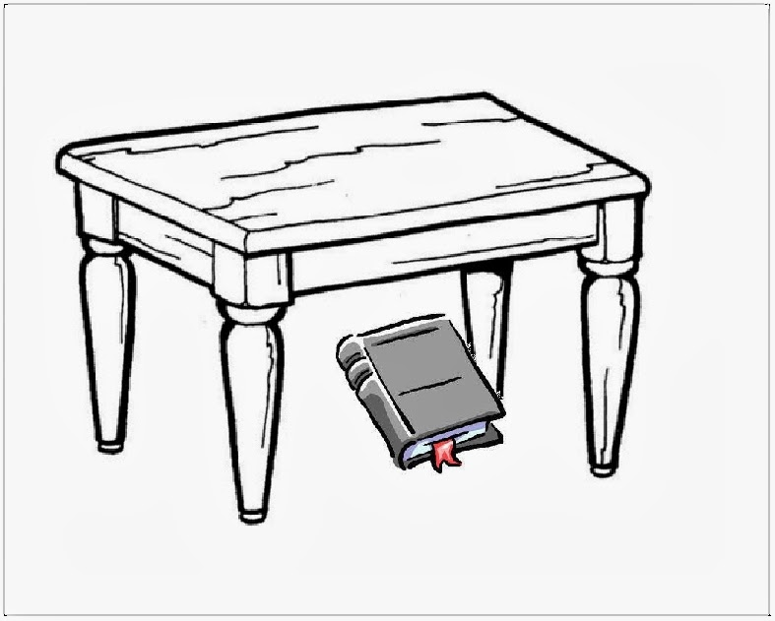
intonation rules:
Rule 3
Rule 3: Stress words that contrast information. Any word, including function words, may be stressed for purposes of contrast.
1. Is the book on the *table?
No, it’s *under the table.
2. Is that for *Mary?
No, it’s *from Mary.
http://leandromd.blogspot.tw/2013/10/aprendendo-ingles-com-learning-english.html

Slide 24
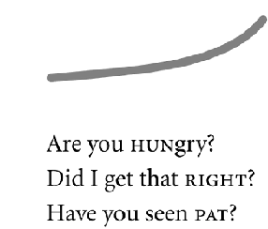
Yes-no Questions
Yes-no questions usually have a rising intonation:
http://flylib.com/books/2/133/1/html/2/images/0321185765/graphics/11fig02.gif

Slide 25
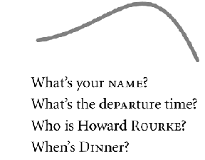
wh- Questions
Wh- questions usually have a falling intonation:
http://flylib.com/books/2/133/1/html/2/images/0321185765/graphics/11fig08.gif

Slide 26
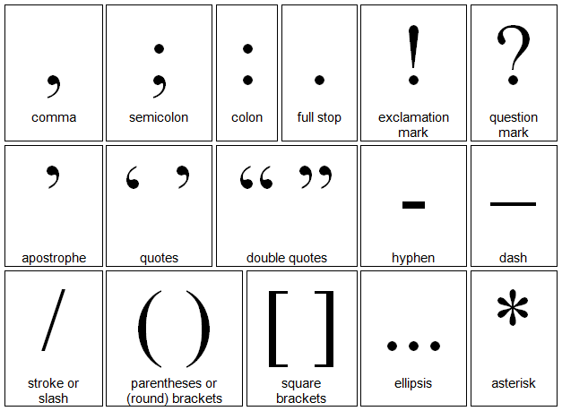
Phrasing: Listen for breaks
Five places to pause in English:
After the complete subject
Before “that” and other clauses
At most punctuation marks
Before conjunctions
Before prepositions
http://1.bp.blogspot.com/-fcGWOIruXyc/VCamzliWmaI/AAAAAAAAAMA/xwBdVZJw8xo/s1600/punctuationmarks.png

Slide 27
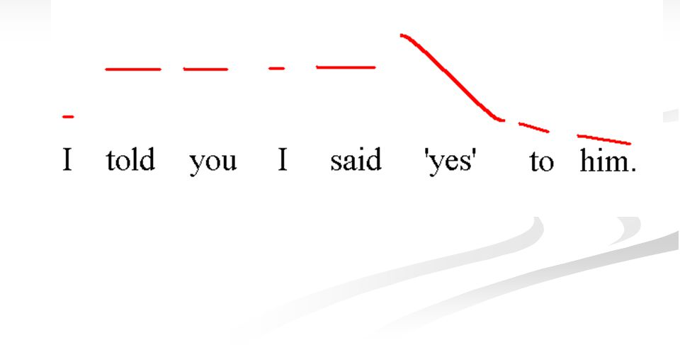
Tonic stress
The last stressed syllable of a compound, phrase or sentence receives
*TONIC STRESS.
http://images.slideplayer.com/14/4407676/slides/slide_29.jpg

Slide 28
end of a sentence:
Tonic stress + fall
Listen for SENTENCE-FINAL
FALLING INTONATION:
If you are at the end of a SENTENCE or a SEMI-COLON:
The stressed syllable in a word with tonic stress has a VERY HIGH PITCH;
The pitch FALLS SHARPLY and doesn’t go up again.
The remaining syllables, if there are any, are read with VERY LOW, EVEN PITCH.

Slide 29
end of a phrase:
Tonic stress + fall + gentle rise
Listen for the CONTINUATION RISE:
If you are only at the end of a COMPOUND or PHRASE
(and NOT the end of the sentence):
The last stressed syllable gets a HIGH PITCH.
The pitch FALLS SHARPLY.
The pitch now GENTLY RISES over the same syllable, if there are no more syllables in the phrase, or over the remaining syllables, if there are any, to signal that it is not the end of the sentence, and that more is still coming.

Slide 30

11. LISTEN for discourse markers
Discourse markers can help orient you
and get you ready for what’s coming.
OK, so…
A common way to start a story.
…right?
A way to check and see
if our listeners are still
following our story.
“Hey,…”
One way of starting a casual conversation out of the blue
with someone.
http://static.oprah.com/images/200303/omag/200303-omag-story-600x411.jpg

Slide 31

12. The Grammar must be correct!
Use your knowledge of grammar
to check what you’ve written –
it MUST be GRAMMATICAL!
Every seat have hold two
people.
I didn’t care they
punched.

Slide 32
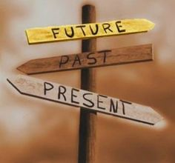
13. Checklist: verbs, Nouns, pronouns
Is the verb intransitive? Make sure it’s followed by a preposition, and the right one!
Does the verb form agree with the subject, i.e. -s for third person singular?
Is the verb in the right tense? Is it “I heard,”
“I’ve heard” or “I’d heard”?
Listen carefully!
Is the noun countable?
Listen for an article
and/or a plural marker
Is the noun uncountable? No -s!
Do you have the right pronouns?
https://s-media-cache-ak0.pinimg.com/236x/be/07/59/be075937aca5f1f0d28856c37a7627bc.jpg

Slide 33
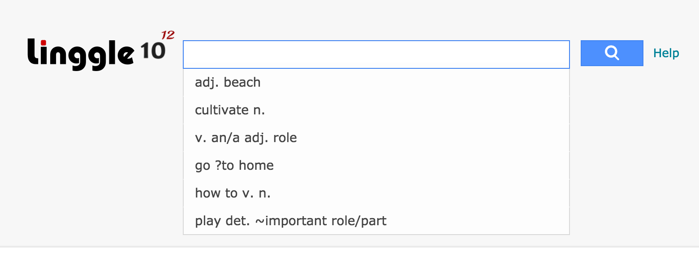

14. Meet linggle and netspeak!
Google is great for checking almost anything. But there are also specialized tools for checking collocations, like Linggle and Netspeak.

Slide 34
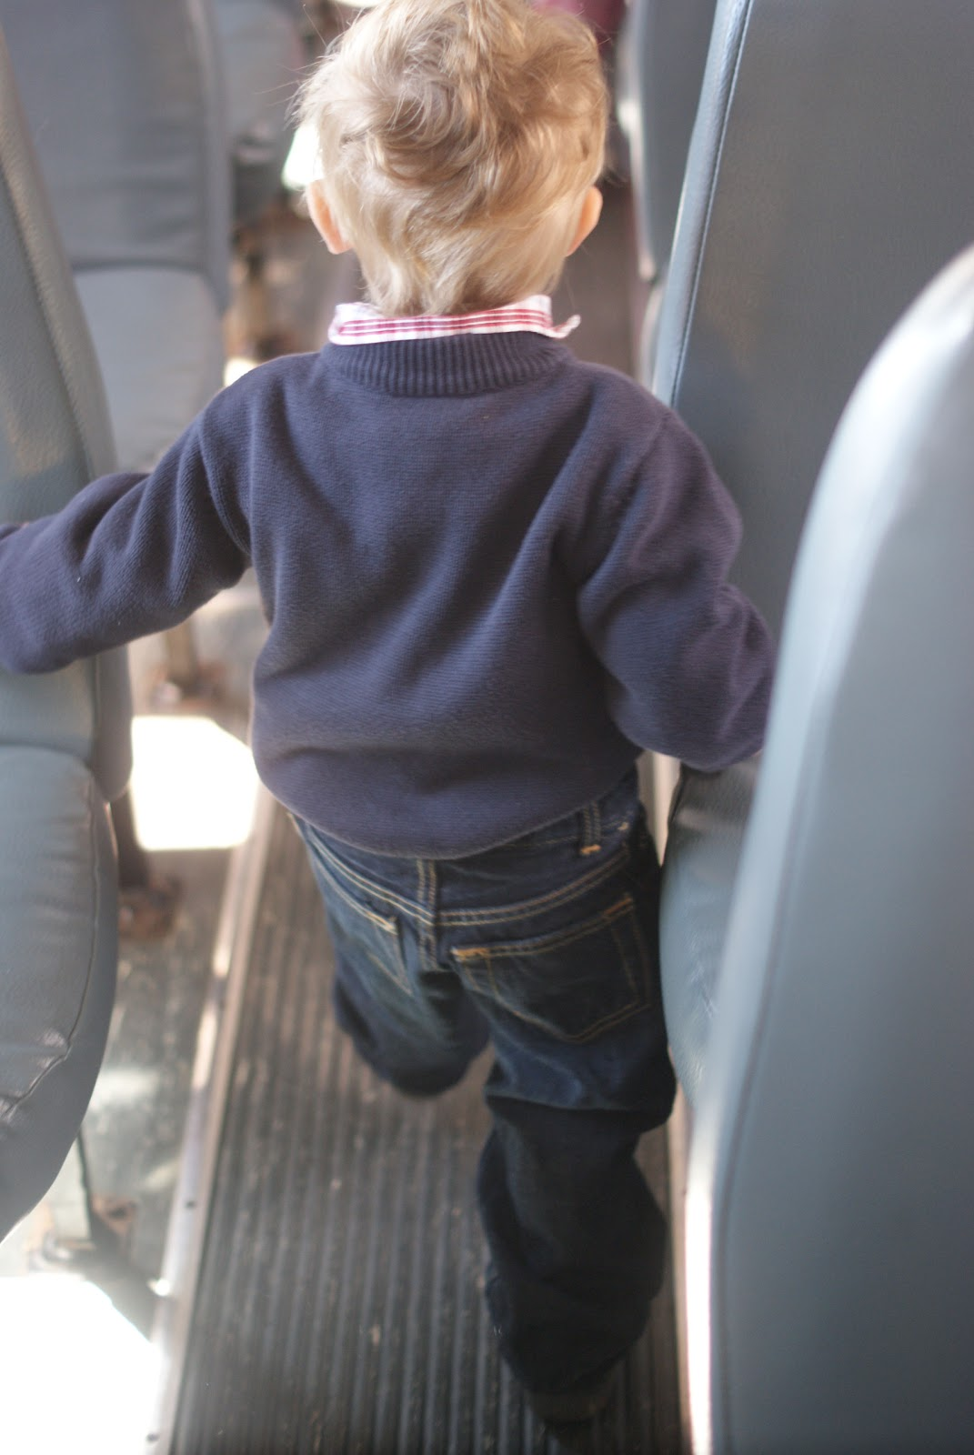
I kept walking ? the aisle.
http://2.bp.blogspot.com/-gpbeSy65Y50/ToE5QoNaL-I/AAAAAAAACB0/YUEgVqx-64s/s1600/aisle+bus.jpg

Slide 35
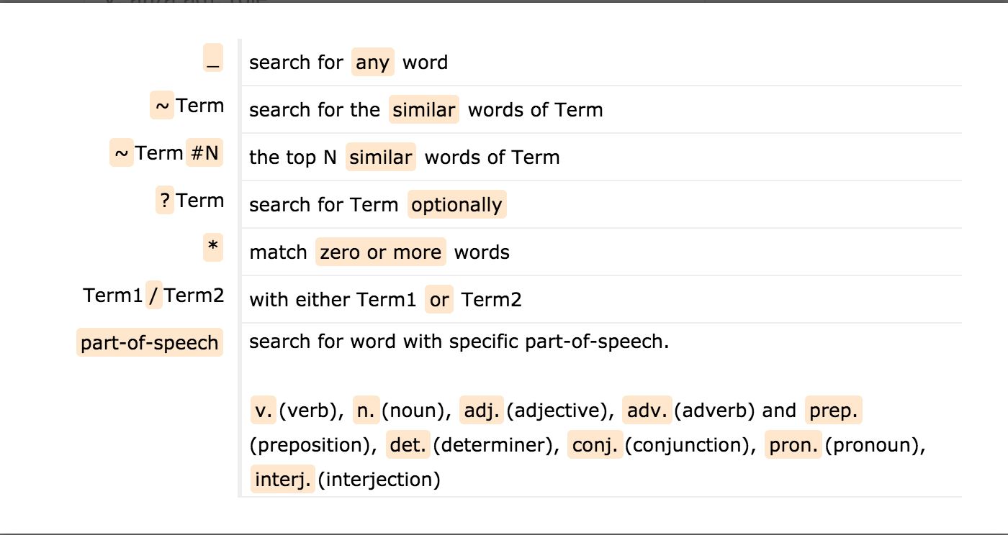
Format for linggle searches

Slide 36
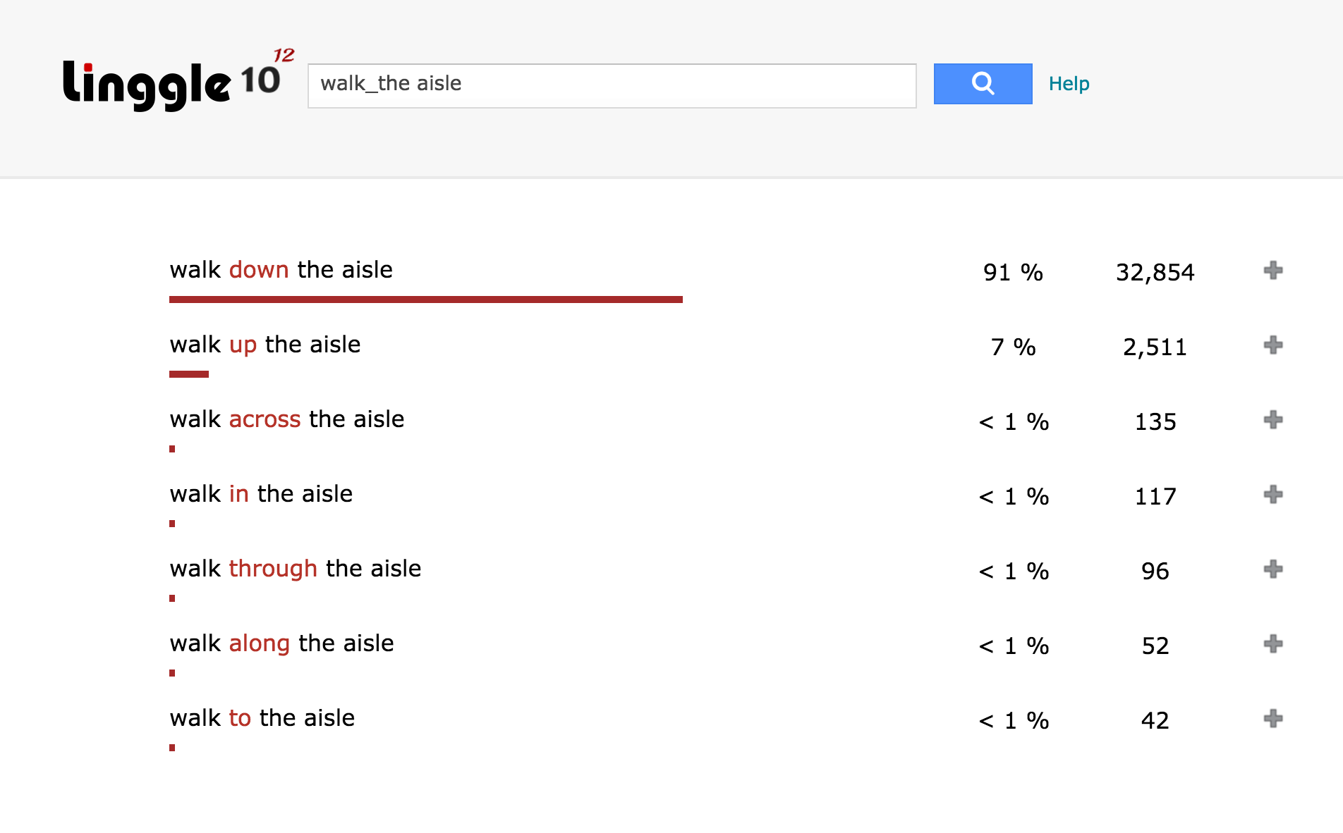
Walk_the Aisle

Slide 37
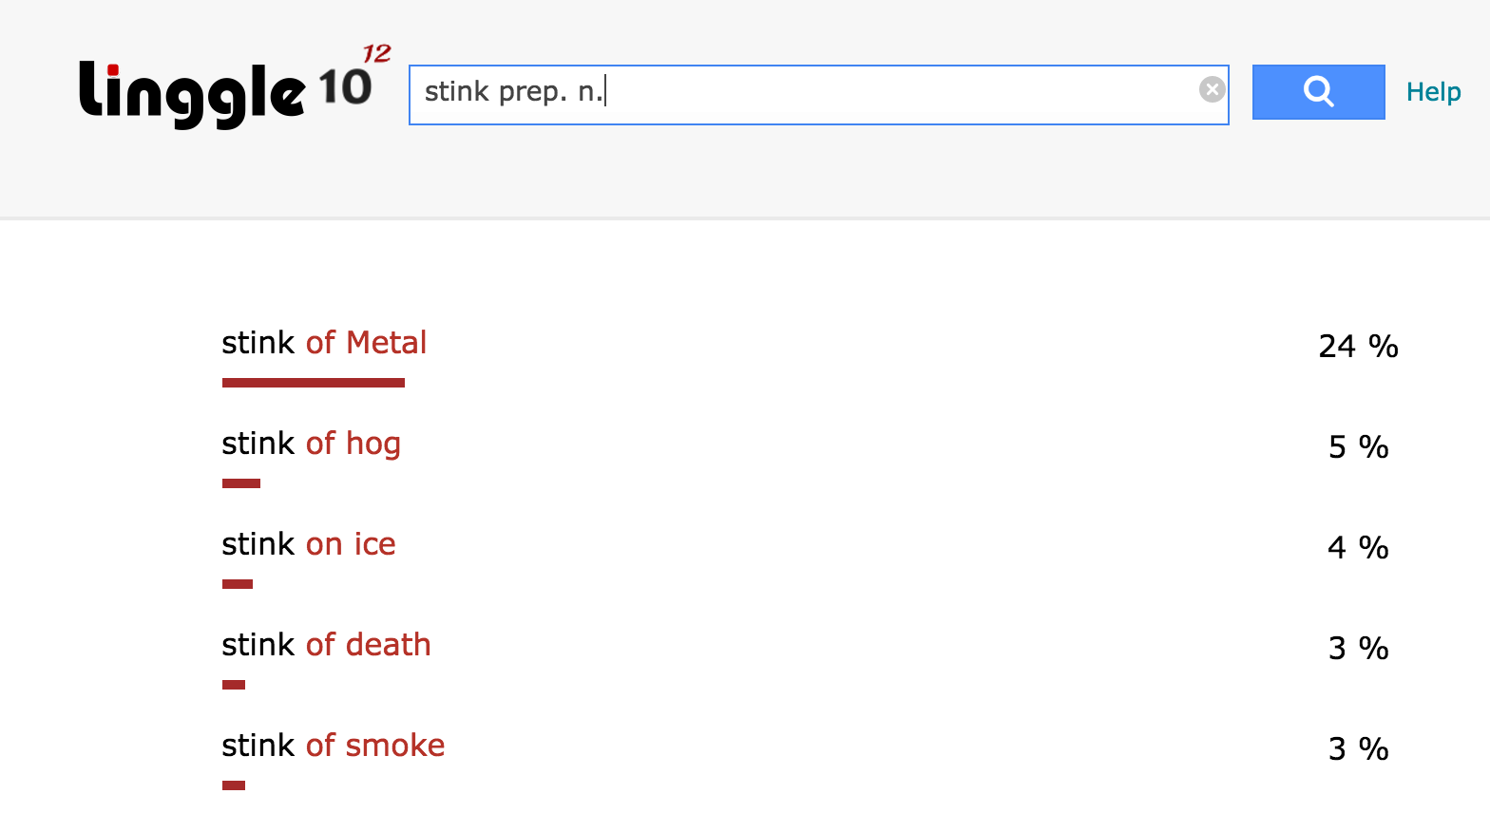
Stink prep. N.

Slide 38
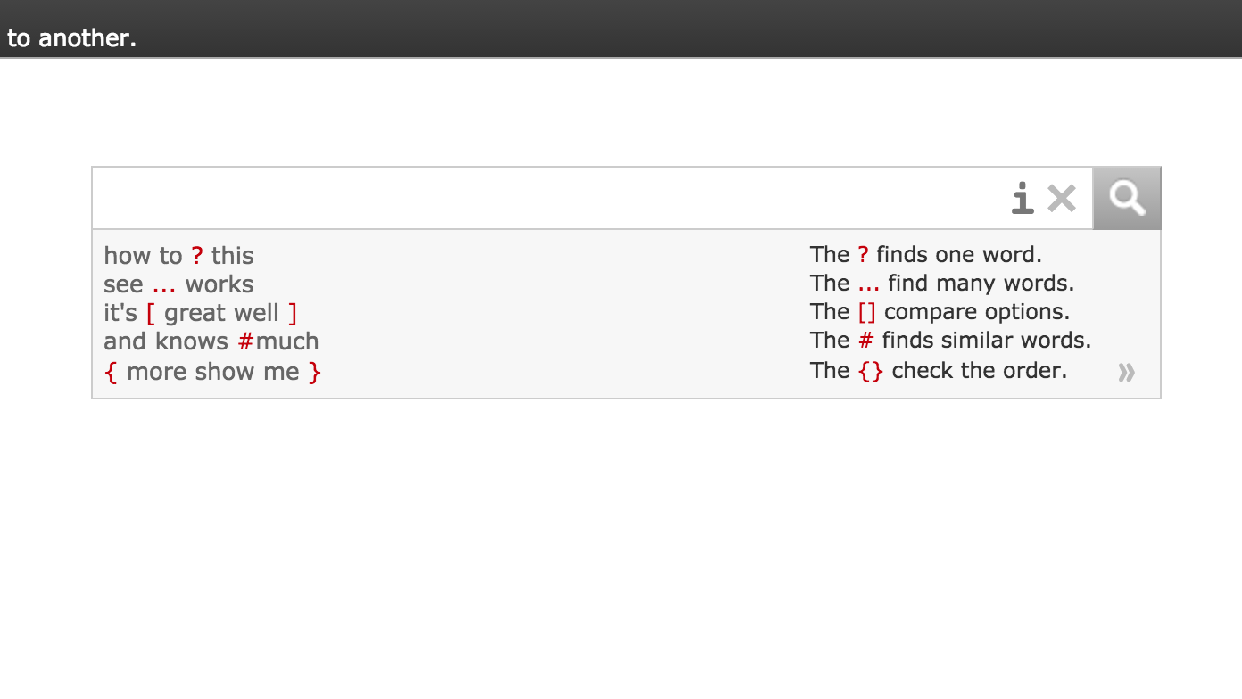
Format for Netspeak searches

Slide 39
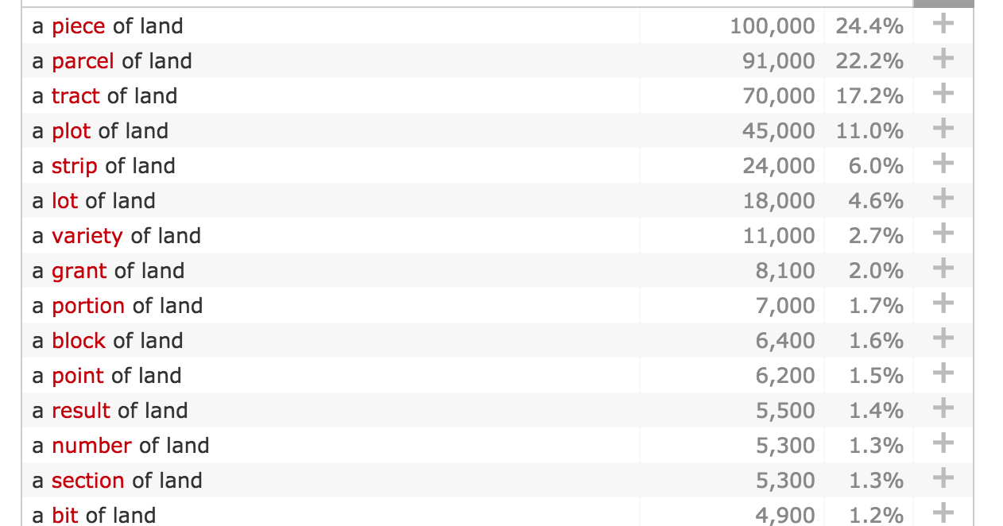
A ? Of land

Slide 40




15. Use images
Check Google IMAGES to know at a glance what unfamiliar objects look like, also commercial brands and other proper nouns
Trapper Keeper
Mobile home
Scooby-Doo (cartoon)
http://images.mentalfloss.com/sites/default/files/styles/insert_main_wide_image/public/lamborghini-trapper-keeper.jpg
http://aarcs.com/mobilehome1.jpg
http://static.tvtropes.org/pmwiki/pub/images/new_scoow_doow_7704.png

Slide 41

16. Recognize self-corrections!
“…our commitment to the rule of law;
our commitment to human rights…”
Q: I could swear I heard
something between “rule of law”
and “our commitment,” or is there
something wrong with my ears?
YOU CAN EDIT OUT MISTAKES AND HESITATIONS!
"We have to judge our commitment to the rule of law; [our trad...our] our commitment to human rights can’t be measured...”
http://www.notbeinggoverned.com/wp-content/uploads/2015/03/tipped-scale-400x271-300x203.jpg

Slide 42
17. Inconsistent Tenses in storytelling
If you are listening to a story, the speaker will
often use the “historical present,” also called the “narrative present” to make listeners feel like
they’re in the middle of the action
But in fact it is much more natural and automatic to speak of things in the past with the past tense
As result, the present and past tenses are often mixed in storytelling
But.. do NOT use this as an excuse to be sloppy with tenses!
Note: “He’s like…” = “He goes...” = “He says/said...”

Slide 43
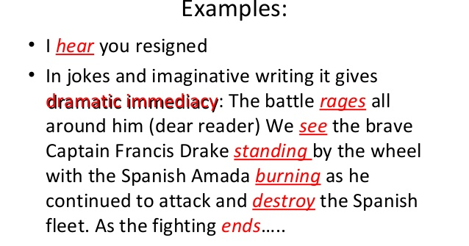
The historical present
http://image.slidesharecdn.com/verbsh2013-130902045017-phpapp02/95/verbs-h2013-37-638.jpg?cb=1378097476

Slide 44
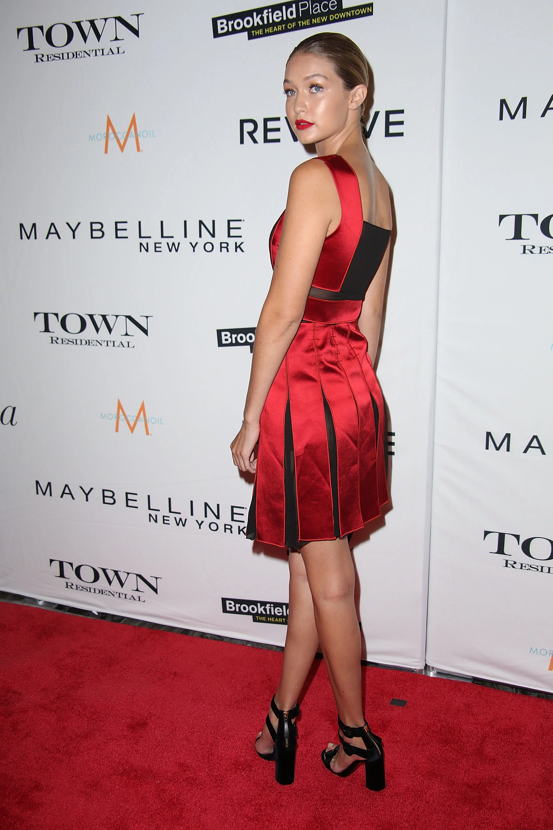
18. Linking CAN HELP YOU!
You may be able to hear an unclear final consonant of a word at the BEGINNING of the NEXT word if it starts with a vowel
turn around?
or: turned around?
Listen for:
Tur naround vs.
Turn daround
http://media4.popsugar-assets.com/files/thumbor/6PMIezXKB3LQNWkAVAA506i0-Sc/fit-in/2048xorig/filters:format_auto-!!-:strip_icc-!!-/2015/09/10/094/n/1922564/a6ae3010a004994f_GettyImages-487638642/i/Gigi-turned-around-show-off-her-design-sheer-details.jpg

Slide 45
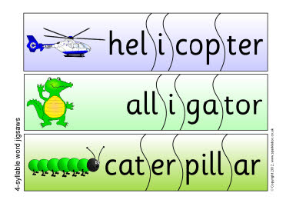
19. Count the syllables!
The word you write MUST have the right number of syllables – if it doesn’t, it must be a different word!
http://www.sparklebox.co.uk/blue/previews/7526-7550/_wp_generated/pp41b1cfa7_0f.jpg

Slide 46
How many syllables?
This trick is VERY useful!
Present or past tense?
If the verb ends with “-t” or “-d,” it will have an extra syllable in the regular “-ed” past tense,
e.g. start, started; dread, dreaded
Singular or plural?
If a word (noun or verb) ends with a sibilant: /s, z, ʃ, ʒ, tʃ, dʒ/ and has a final “es” to mark a plural or third-person singular verb, or a possessive “’s”, it will have an extra syllable, e.g. rose, roses; choice, choices
So sometimes you can determine if a word is present or past, singular or plural by counting syllables!

Slide 47

20. Tell yourself a story in Chinese
When part of the story is unclear, think carefully about what you DO hear clearly
Sit back and tell the part you know to yourself as a story IN CHINESE
Your brain will often AUTOMATICALLY fill in the blank with the right word(s) in Chinese
Now listen to the passage again, and translate your Chinese story into English!
http://www.naturalawakeningshawaii.com/images/cache/cache_f/cache_0/cache_a/HI_Talking-61c09a0f.jpeg?ver=1472037431&aspectratio=1.4026845637584

Slide 48

The words will come out automatically!
Example: Every seat ___________ __________
(2 syllables) two people.
Chinese: 每一個座位
_____ _____ _____
兩個人。
English?
http://safeguardseat.com/wp-content/uploads/2012/11/Base-Seat.png

Slide 49
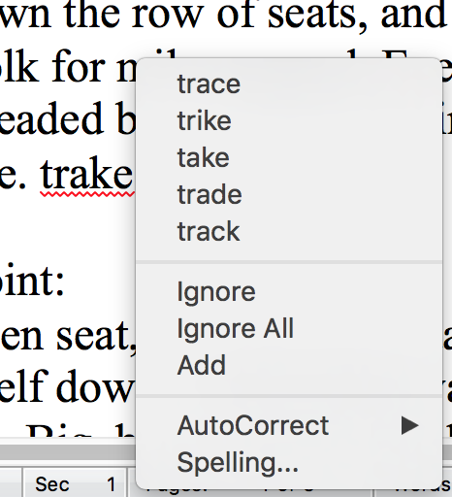
21. Right-click for possibilities
When you’re not sure of
a word or how to spell it,
or when you see a red,
squiggly line, right-click
in Word, and it will show
you some words that are
similar to what you’ve typed,
with the correct spelling!
OneLook and Google will also show a contextual menu of options as you type in your query – don’t ignore them! They may be just what you need!

Slide 50
22. Use onelook’s search tools
You can find words with “wildcards”:
? stands for one single character 字元
* stands for any number of 若干letters/characters
# stands for one consonant
@ stands for one vowel
Use expand:nasa for acronyms
Make sure you click on “Common words only” to narrow down the choices

Slide 51
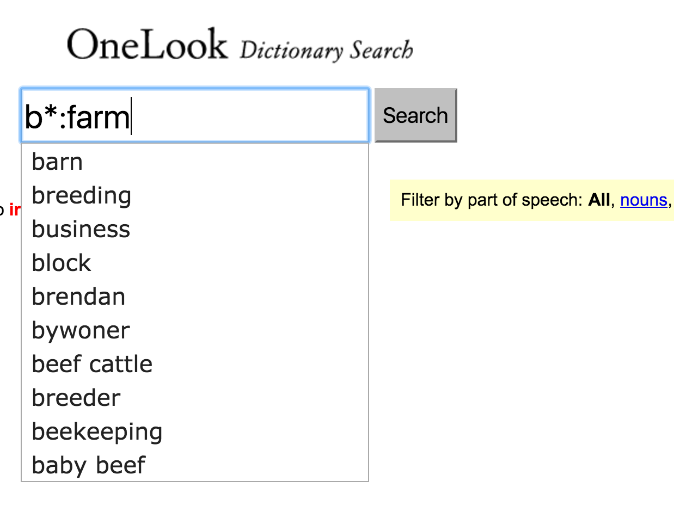
Find related words in the onelook Reverse dictionary
If you can’t hear a word clearly, and you’ve
never learned the word before, what can you do?
Type in the letters
of the sounds you
hear, then *:
then the topic, e.g.
b*: farm
First match:
the target word
barn

Slide 52
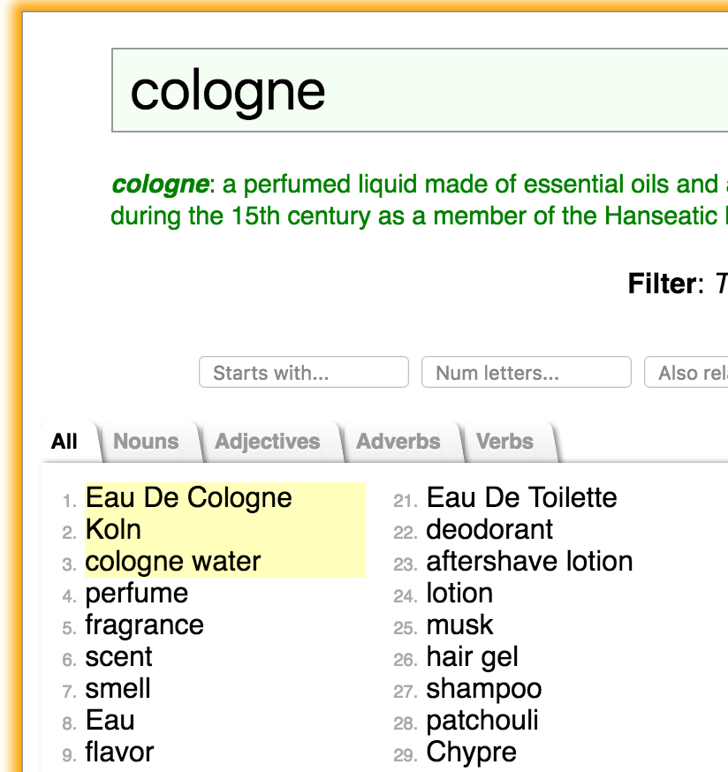
onelook reverse dictionary
Use OneLook Thesaurus/Reverse Dictionary filters:
Synonyms
Starts with
Number of letters
Also related to
Rhymes with
Sounds like
Vowels like
Number of syllables
Phrases, e.g. **birds**
http://www.onelook.com/thesaurus/

Slide 53
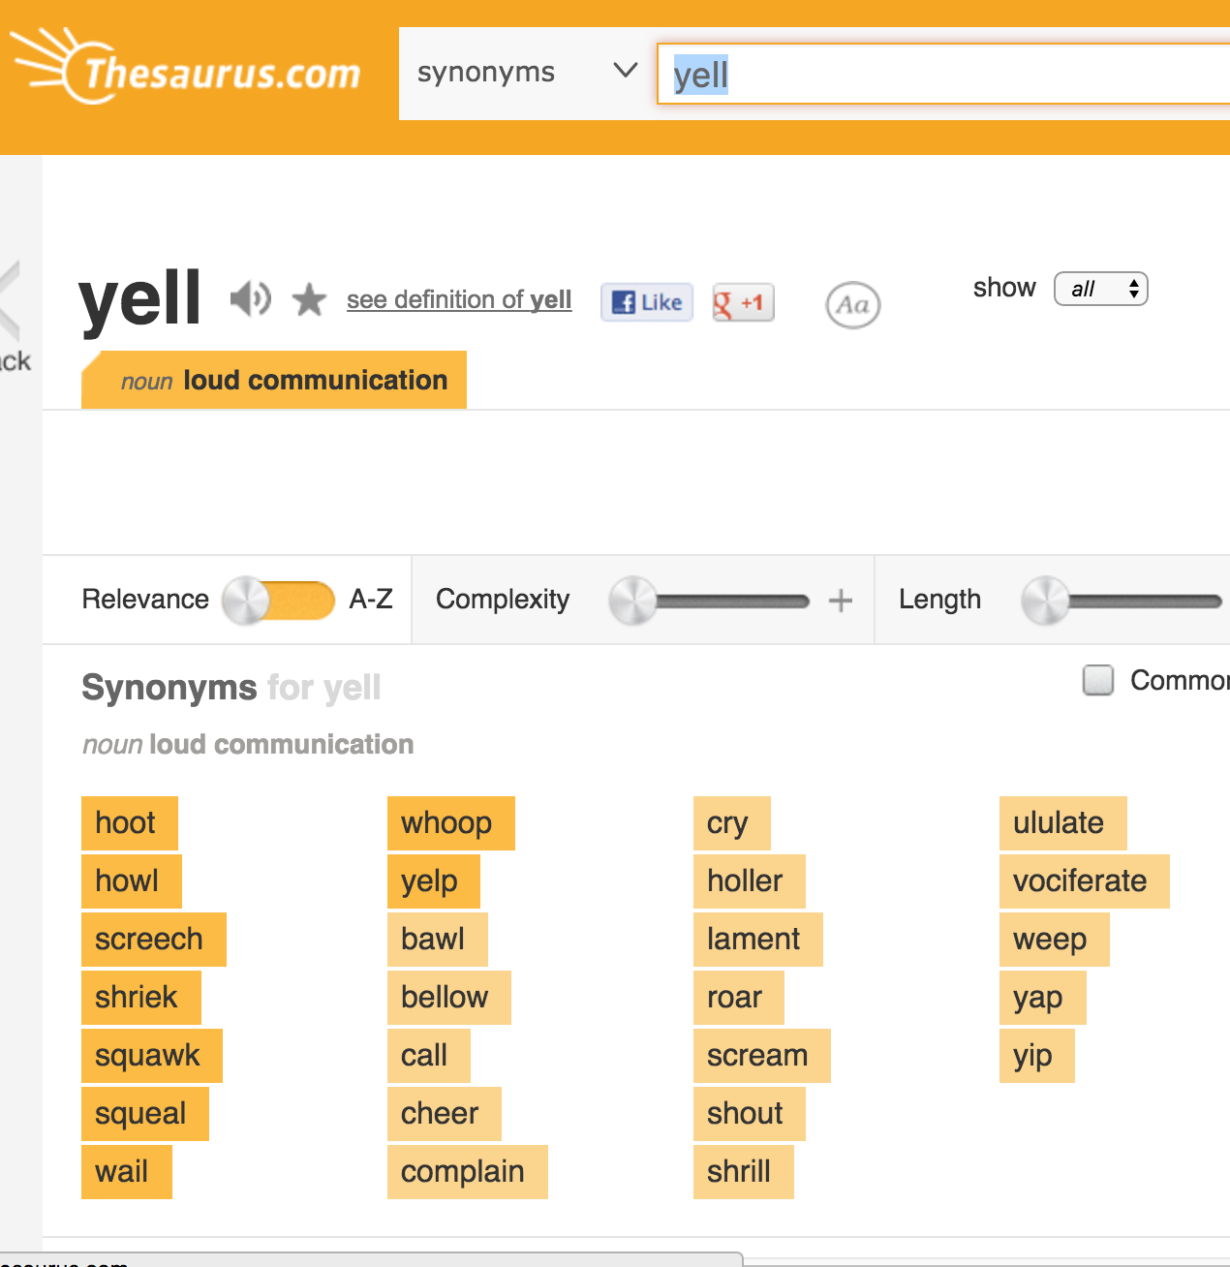
Or use a conventional thesaurus
http://www.thesaurus.com/

Slide 54
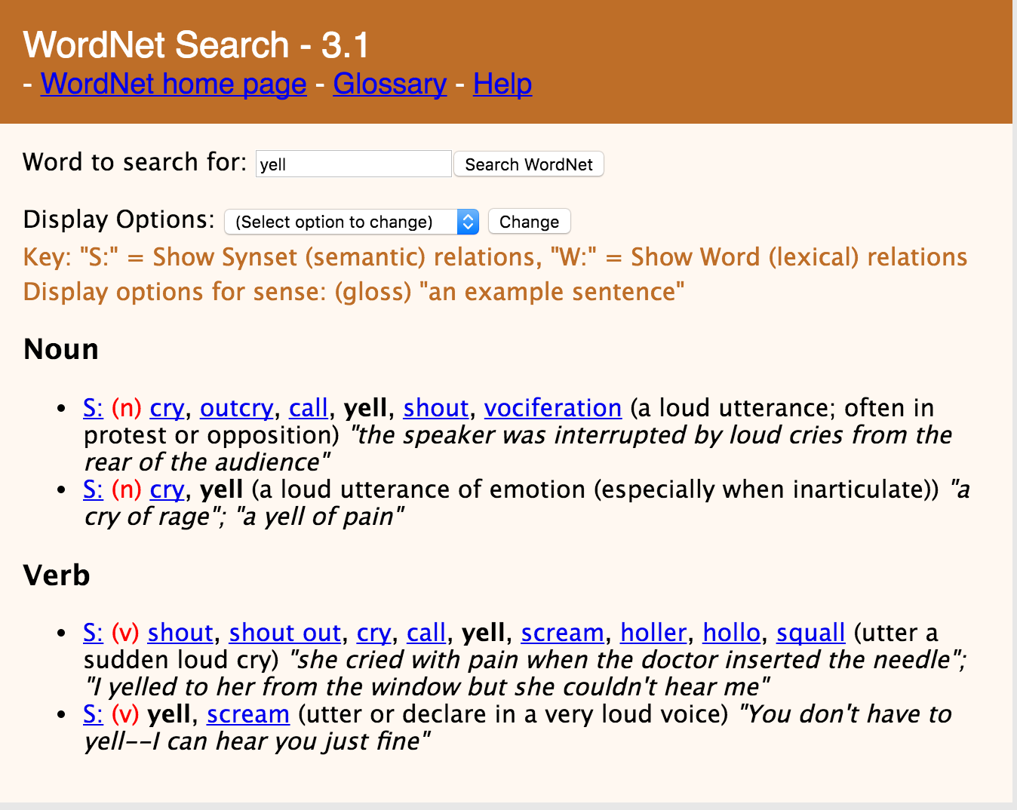
Or wordnet
http://wordnetweb.princeton.edu/perl/webwn

Slide 55

23. Watch out for capitalization
If all/almost all the dictionaries in OneLook spell your word with a capital letter, it’s probably a proper noun and not what you want, e.g.
Bari
Tokay
Debs
https://upload.wikimedia.org/wikipedia/commons/a/af/The_port_of_Bari,_Italy_(L._Massoptier).jpg

Slide 56
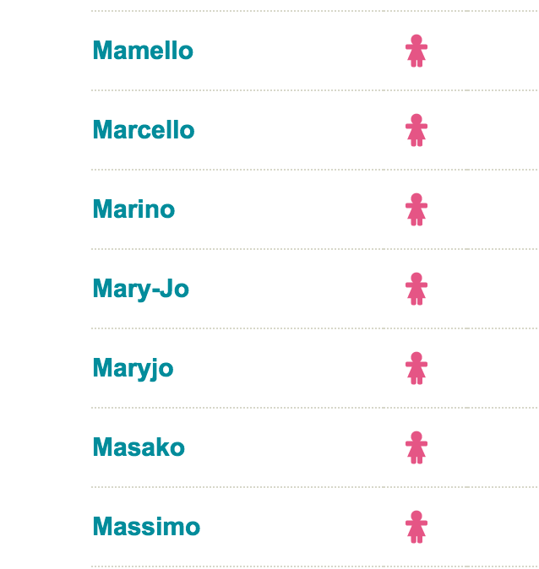
24. Try boy/girl Baby name pages for unfamiliar personal names
Girls and Boys are listed separately, usually alphabetically
On some sites you can do an “Advanced Search,” where you can input some of the letters and the number of syllables
Names will often have an independent intonation,
with each name stressed,
and tonic accent on the
last stress:
CHARles RObert*DARwin
http://www.babycenter.com/baby-names

Slide 57
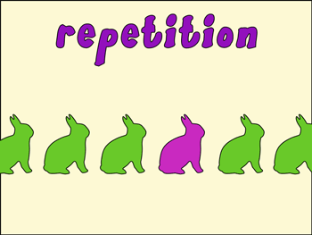
25. listen for repetition
Repeated material gives you a second or third chance to hear the same word(s) again
However, because it is old information, it will often be pronounced very quickly and less clearly the second or third time around. In this case, go back to the first mention to hear it more clearly.
http://www.nhsdesigns.com/images/principles/repetition_poster_example1.gif

Slide 58
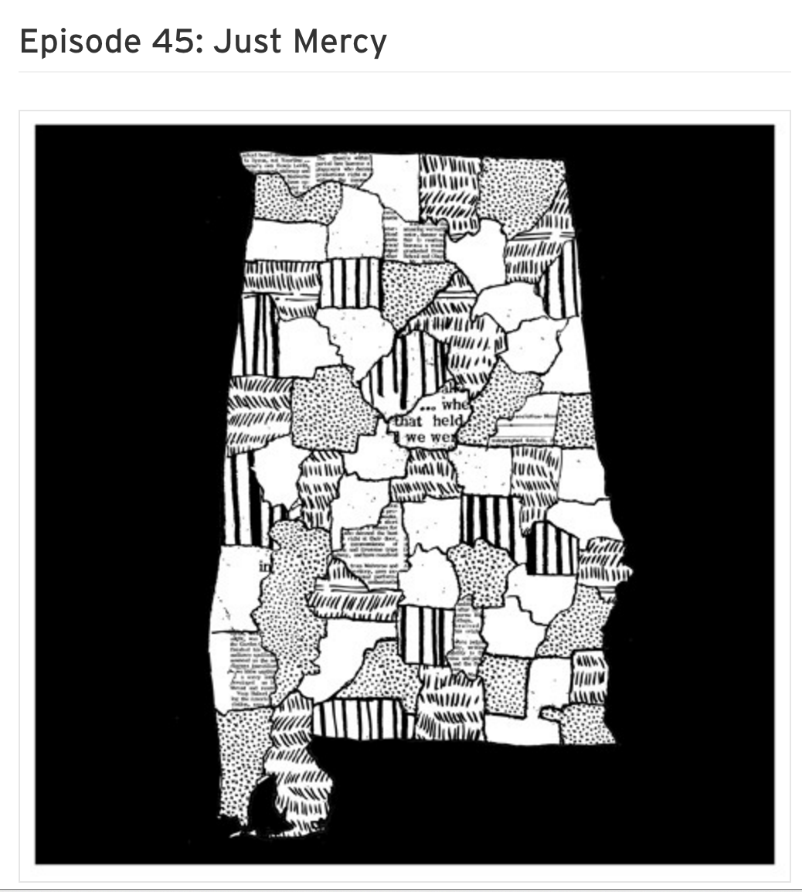
Example of repetition
Example: In “Just Mercy”:
“…how we treat the rich, the powerful, and the privileged. We have to judge our commitment to justice, to the rule of law, to human rights, by not looking at how we treat the rich, and the powerful, and the privileged.”
On the second mention, “the privileged” is fast and unclear; it sounds like [ˈprɪʐɪ] ([ʐ] sounds like 日)
https://soundcloud.com/criminalshow/episode-45-just-mercy

Slide 59
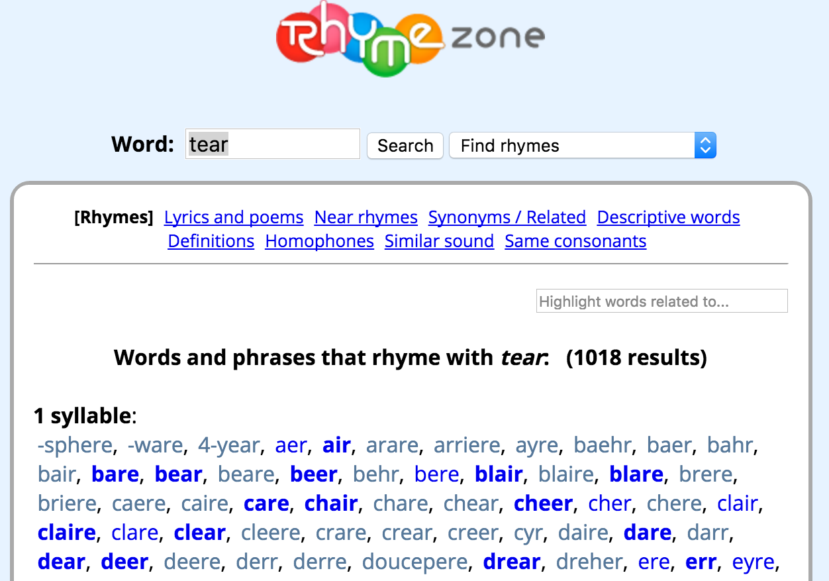
26. Use parallelism and rhyme
Parallelism can help you retrieve missing words, e.g.
Nobody's RICH, but some of us are really ? .
Rhymes: Use OneLook or Rhymezone e.g.: It’s showing signs of ? and tear. http://www.rhymezone.com/

Slide 60
27. dropped “h-” in pronouns
The initial /h/ sound is often dropped in
unstressed non-initial pronouns, e.g.:
          he = ’e e.g. “Here ’e is!”
          him = ’im e.g. “Give it to ’im!”
          his = ’is e.g. “There’s ’is sister!”
          her = ’er e.g. “Look at ’er go!”
          Also:
          them = ’em e.g. “Tell ’em the answer!”

Slide 61
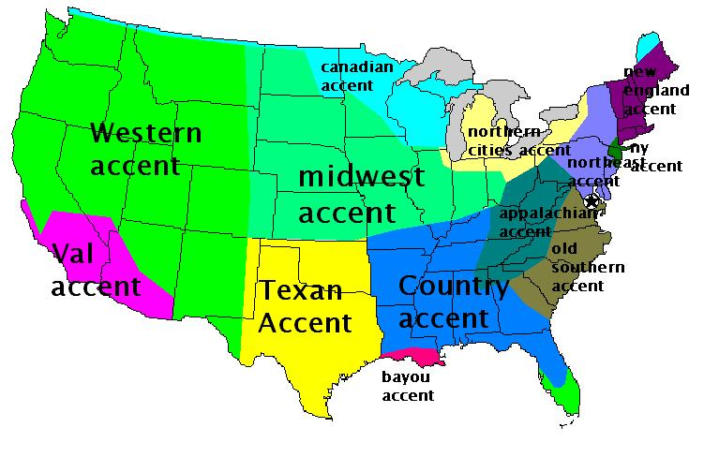
28. Learn common dialect equivalents
Learn and get used to some of the main features of Southern and Black US English and other major dialects
Examples:
“I”: General American [aɪ] = Southern/Black US English [a] “pen”: GA [ɛn] = S/BE [ɪn]
https://mrupert.files.wordpress.com/2013/03/accents.jpg

Slide 62

29. Logic, coherence, background
Translate the story into Chinese in your head. Does everything fit together and make sense? If anything is at all odd, follow up on it – there may be a misunderstanding.
Make sure you understand something of the background of each story, for example, just how sensitive race relations are in the US.
https://i.guim.co.uk/img/media/37cb937a75ca9867bceb046172e56db5189f9576/0_0_5616_3370/master/5616.jpg?w=620&q=55&auto=format&usm=12&fit=max&s=6ab7e38ace2e990763e9712e40f0cdb4

Slide 63
COMBINE THESE TRICKS!
You will often need to use
more than one of these tricks
in the same phrase!

Slide 64
Last trick:
When all else fails…

Slide 65

30. GUESS!!!
http://guessthemovie-answers.com/wp-content/uploads/2014/04/guessthemovie-lrg-138.jpg

Slide 66

What clever tricks have you discovered?
Please share them with us!
http://mybrainllc.com/wp-content/uploads/2015/07/share-ideas.jpg

Slide 67

Links
!
Karen on Ivy League Analytical English
https://www.facebook.com/Karen-on-Ivy-League-Analytical-English-234235001756/
師德 articles on pronunciation and grammar:
http://homepage.ntu.edu.tw/~karchung/Karen/Karen_Chung_publications.htm#CET
Subscribe to our Email Updates list: http://eepurl.com/505qT
Online Phonetics course:
http://ocw.aca.ntu.edu.tw/ntu-ocw/index.php/ocw/cou/101S102
Practice Dictations:
http://homepage.ntu.edu.tw/~karchung/phonetics/dictations.htm
Mini-conversations with Echo files:
http://homepage.ntu.edu.tw/~karchung/miniconversations/MC.htm

