Slide 1
What is Linguistics?

Slide 2
Linguistics is the scientific study of human natural language.

Slide 3
Theoretical linguistics involves the systematic and analytical study of: speech sounds, words, sentences, meaning, and discourse, and how they evolve over time.

Slide 4
Applied linguistics involves: the mental, social, cultural, and educational aspects of language.

Slide 5
What linguistics is not:
Mulitlingualism or polyglottism
Translation or interpretation
Prescriptive grammar

Slide 6
Subfields of linguistics include:
Phonetics and Phonology
Morphology
Syntax
Semantics
Pragmatics
Sociolinguistics

Slide 7
Historical Linguistics
First and Second Language Acquisition
Psycholingustics and Psychology of Language
Neurolinguistics
Evolution of Language
Study of Writing Systems

Slide 8
The first step to studying linguistics is to open your ears!

Slide 9
Linguists are interested in questions like:

Slide 10
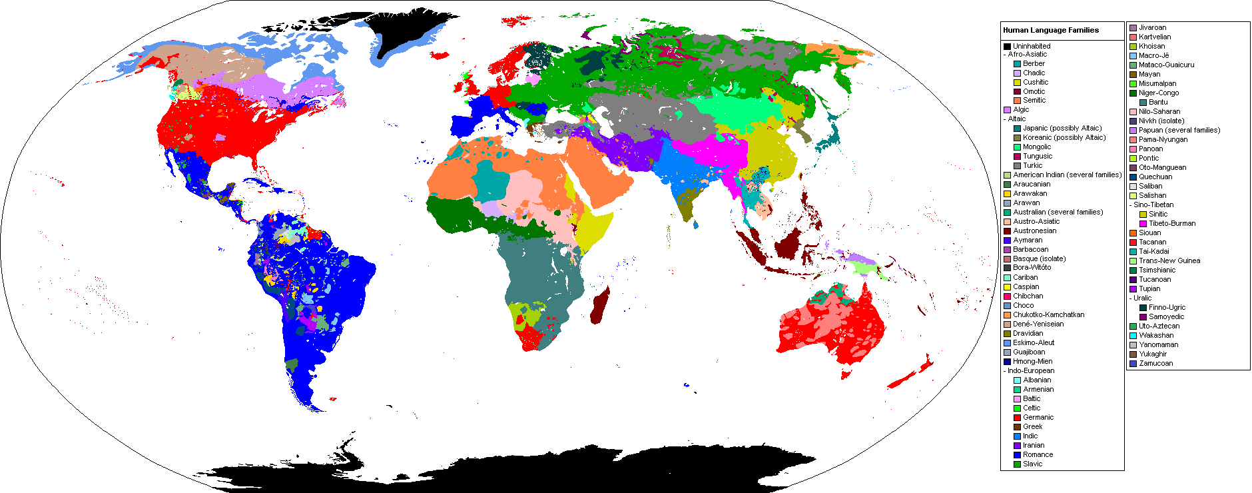
How many languages are there in the world?

Slide 11
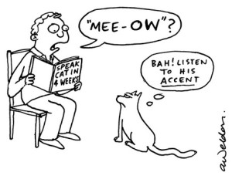
What is the difference between a language, a dialect, and an accent?

Slide 12
How can we analyze the grammar or syntax of a sentence with a tree?

Slide 13
What do languages have in common and how do they differ?

Slide 14
How do languages emerge? How and why do they change?

Slide 15
What is the relationship between language and culture?

Slide 16
How are world events influenced by contact between groups that speak different languages?

Slide 17
How does language influence thinking or perceptions of the world?

Slide 18
How do children learn their first languages?

Slide 19
do conversations follow rules?

Slide 20
How do children and adults learn second languages?

Slide 21
How can I be a better teacher of English or Chinese learners?

Slide 22
Places to learn about linguistics:

Slide 23
Language classes literature and other classes everyday life tutoring and work

Slide 24
clubs and activities the media online travel anywhere, any time!

Slide 25
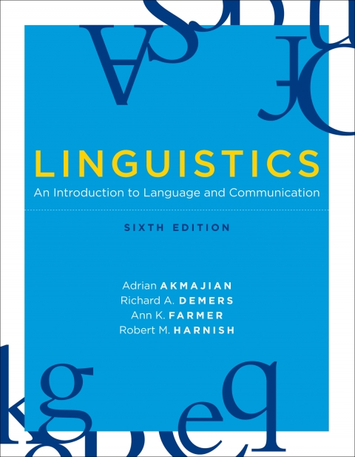
Linguistics offers you a new, more aware way of experiencing life and the world!
Don’t get bogged down in boring linguistics texts…

Slide 26
TEXT Source
http://www.cla.csulb.edu/departments/linguistics/about-linguistics/

Slide 27
Image sources
http://cepb1.blogspot.tw/2014/11/open-your-ears.html
https://multiculturalmeanderings.wordpress.com/tag/world-languages/
http://fluentfocus.com/english-language-dialects/
http://www.qd1919.com/surreal-trees.html
https://www.pinterest.com/pin/188095721912085914/
http://stackoverflow.com/questions/17342983/display-syntax-trees-in-webpage
https://illinois.edu/blog/files/25/90941/3133.jpg
http://www.ciee.org/study-abroad/morocco/rabat/language-culture/
http://blogs.scientificamerican.com/observations/are-the-durban-climate-talks-or-climate-talks-in-general-doomed/
http://www.azquotes.com/author/23941-Benjamin_Lee_Whorf
http://www.sciencedaily.com/releases/2014/09/140916112242.htm
http://www.slideshare.net/kparuk/theories-of-conversation
http://www.theguardian.com/world/2011/mar/16/germans-sensitive-names-children-teased
http://teach-english-travel-overseas.com/teaching-tips/tip-learn-your-students-names
https://mitpress.mit.edu/authors/adrian-akmajian

